Slide 1

Cyclistic Case Study
Ermias Molla
July 2022
Source
Divvy: Data License Agreement | Divvy Bikes
Data from June 2021-May 2022

Slide 2
Hi, I’m Ermias Molla
Contact me
Linkedin: https://www.linkedin.com/in/ermias-molla/
Github: https://github.com/Ermiasmolla
Email: MollaErmias@gmail.com

Slide 3
Background
Cyclistic launched in 2016 as a bike-share service. Since then, the program has grown to a fleet of 5,824 bicycles that are geotracked and locked into a network of 692 stations across Chicago. The bikes can be unlocked from one station and returned to any other station in the system anytime.
There are Members and Casual Riders. Cyclistic’s finance analysts have concluded that annual members are much more profitable than casual riders. Cyclistic’s believes that maximizing the number of annual members will be key to future growth.

Slide 4
Challenge: Design marketing strategies in order to convert casual riders into annual members
Identify the key differences in usage between members and casual riders

Slide 5
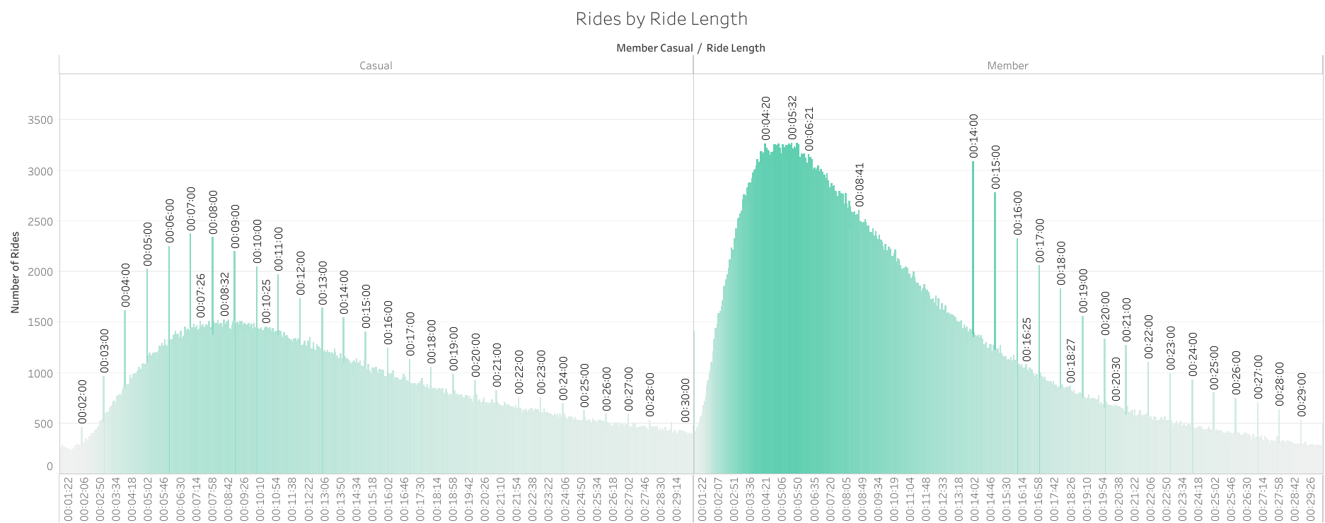
Casual riders are riding for longer periods of time, on average more than double the time of Members.
Mean ride length
Casual Member | 27 minutes 15.8 seconds 12 minutes 51.8 seconds

Slide 6
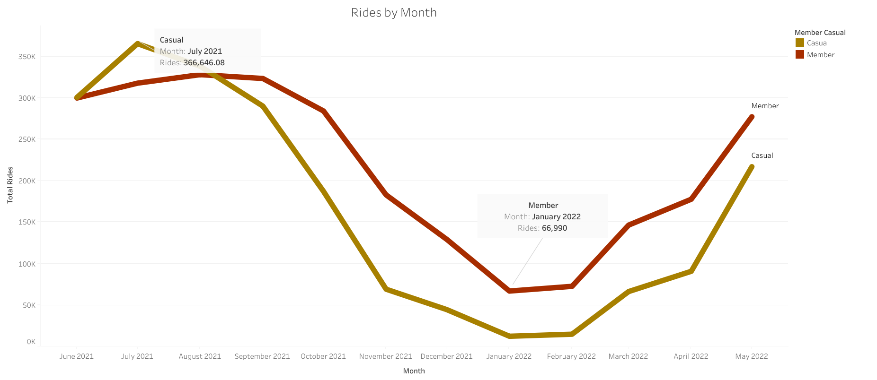
Both Casual and Member riders have significant lows in the Winter Season. Casual Riders have a wider range from Highest use to lowest use.

Slide 7
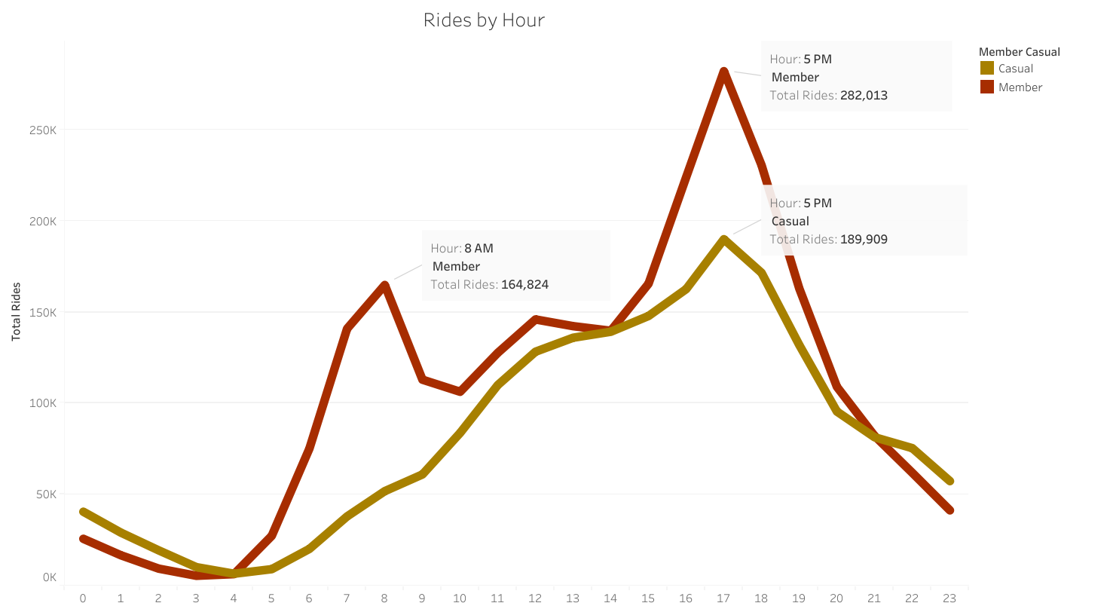
Member Riders have peaks at 8 A.M. and 5 P.M. correlating with work shifts.
Casual Riders have A gradual increase until Peak rides at 5 P.M.

Slide 8
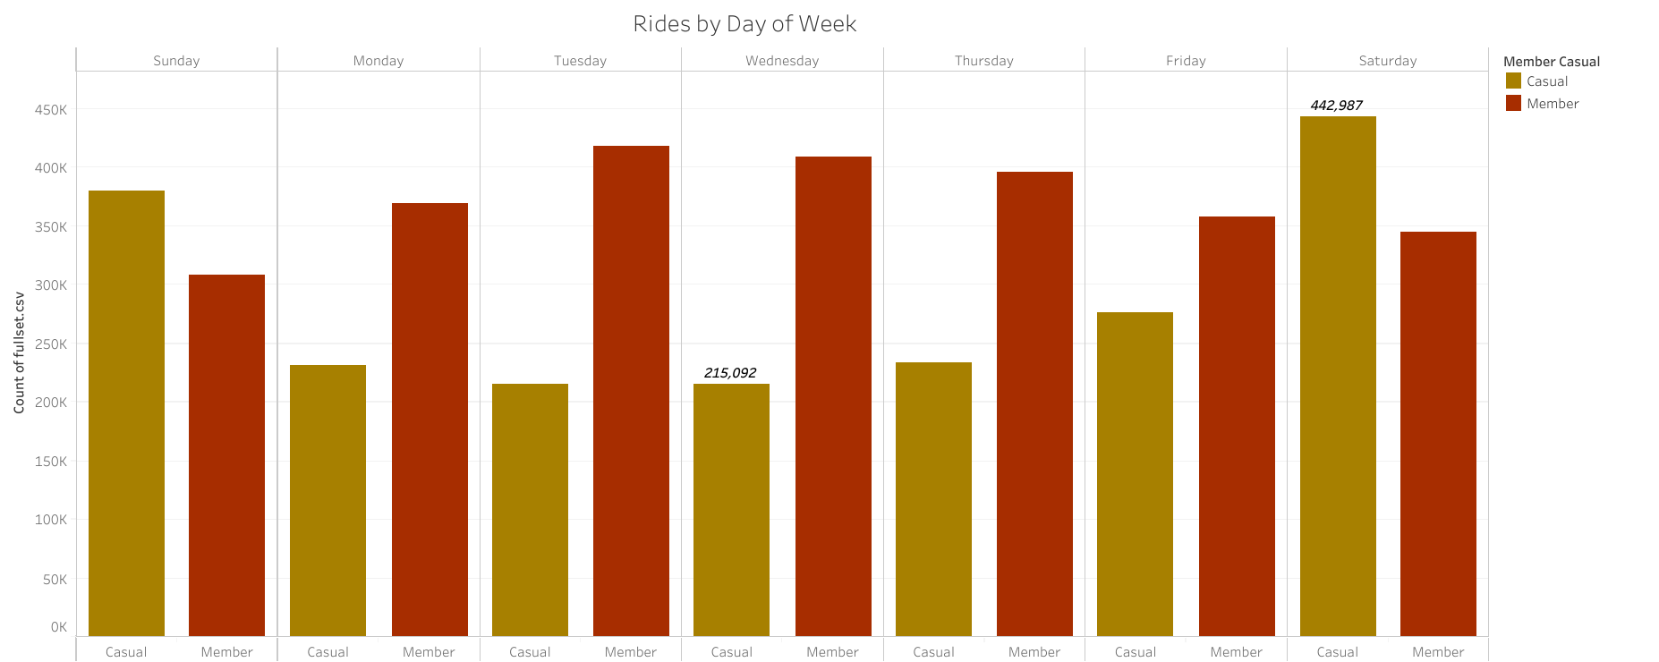
Casual riders have a wide range of riders per day which peak on Weekends Members are steady throughout the Week with slight dips on Weekends

Slide 9
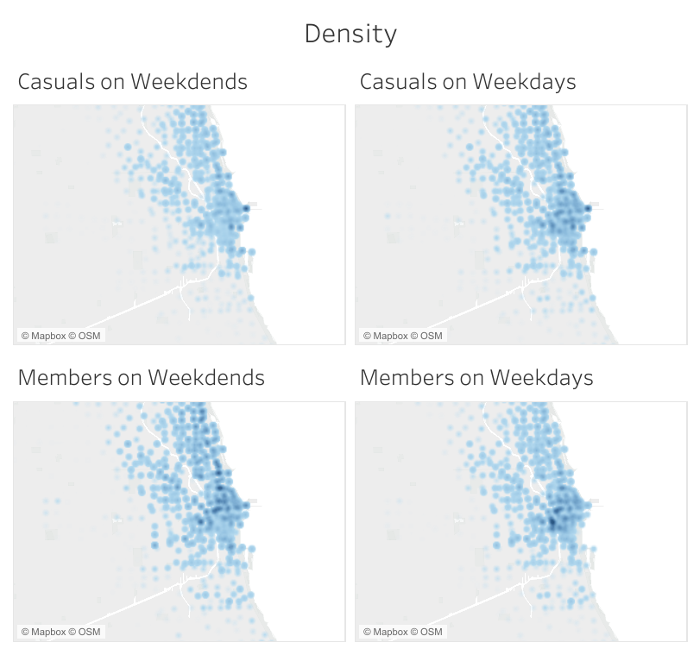
Differences in Density of start stations
Casual: More likely to use bikes near lake Michigan and other tourist hotspots with more rides on weekends indicating people are using the bike for leisure
Members: More likely to use in the downtown area and on weekdays, indicating these users are commuters to the city for work.

Slide 10
Recommendation One
Lower incremental rates for longer use.
We see that Casual riders are on the bikes for longer periods of time. To encourage longer use we should decrease the charge per minute for members. After 15 minutes of use we can decrease the minute rate by a certain percentage. The mean ride time for casual riders is 27 minutes while member mean ride time is 12. If we charge less for member to use after 15 minutes, it will lead to casual riders converting to members to ride the bikes longer.

Slide 11
Recommendation Two
Reduced fare at specific time of day and day of week.
The other Major difference is linked with time. We see Casual rider’s ride at different hours of the day and different days of the week. We could have a reduced price for Members to ride after 6 and during the noon hour. This would attract our casual members because their use is not based on work hours. It would also have the benefit of making sure we have enough bikes for current member when they need it most at 5 P.M. These reduced member prices should also be in place on weekends. This is the highest traffic time for casual riders. If we have these price changes in place, we will be offering a lower price for members when casual riders most want to ride.

Slide 12
Recommendation Three
Location based discounts and activities
We observe the top 5 locations being near lakeshore drive and near tourist attractions such as the aquarium. We can assume that this is due to their primary use for the service being for leisurely activities. With leisure in mind, a recommendation I would give is to incentivize these activities. We can work with the city to give large discounts to members for public events. We can also give guided tours for tourists on the lake shore. Using these methods, we meet the casual rider’s needs.

Slide 13
Conclusion
These recommendations are intended to support the type of use the casual riders already have. It doesn’t increase cost for current members, but it does spread out the time that bikes are in use. This benefits current members as well as casual rider who become members.
If there are questions, please ask after the presentation.
Thank you!

